Slide 1
APUSH
Unit 1 Chapter 1 notes
New World Beginnings

Slide 2
Timeline up to human inhabitation of N. America
225 Million Years Ago - Pangaea started to break apart.
10 Million Years Ago - North America was shaped by nature - Canadian Shield
2 Million Years Ago- Great Ice Age
35,000 Years Ago - The oceans were glaciers and the sea level dropped, leaving an isthmus connecting Asia and North America. The Bering Isthmus was crossed by people going into North America.
10,000 Years Ago - Ice started to retreat and melt, raising the sea levels and covering up the Bering Isthmus.

Slide 3
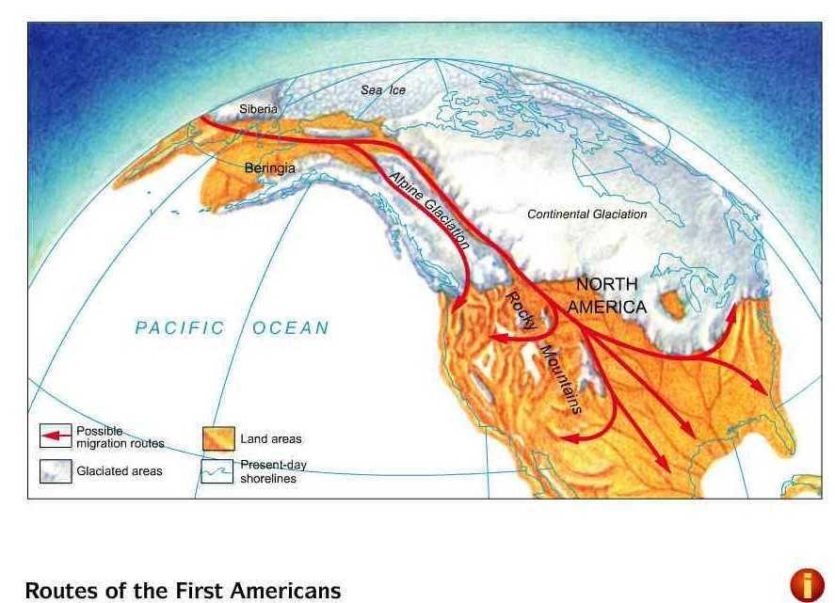
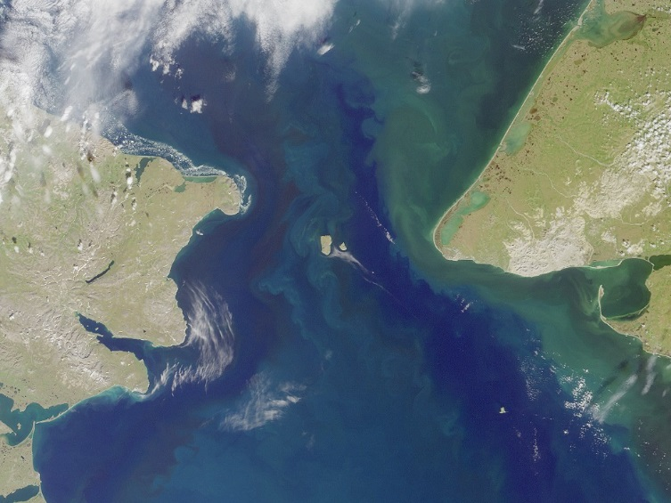
Peopling the Americas
Bering Land Bridge
At the time of Columbus, 54 million natives were in the Americas.

Slide 4
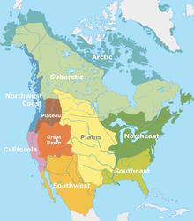
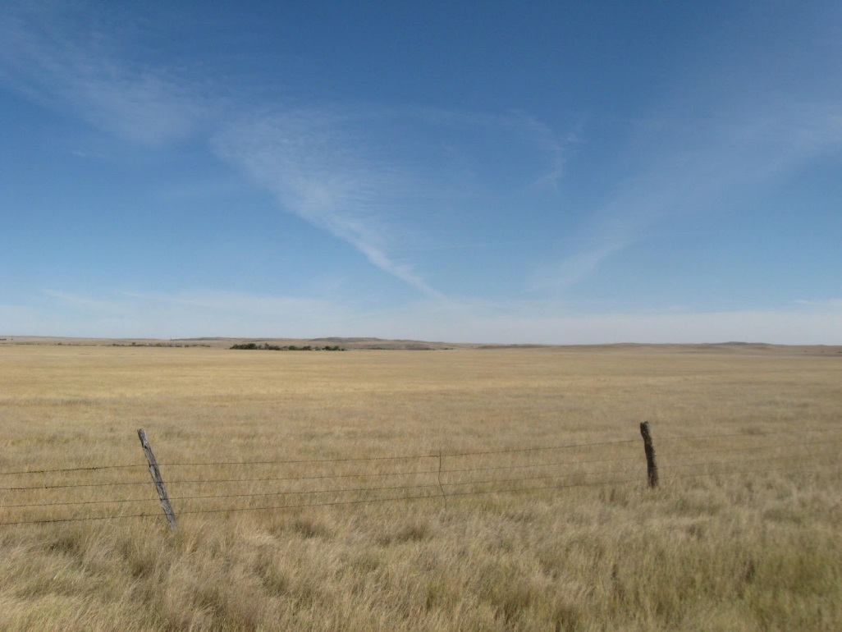
The Earliest Americans
Overall low population density
Except Mexico and the Aztecs

Slide 5
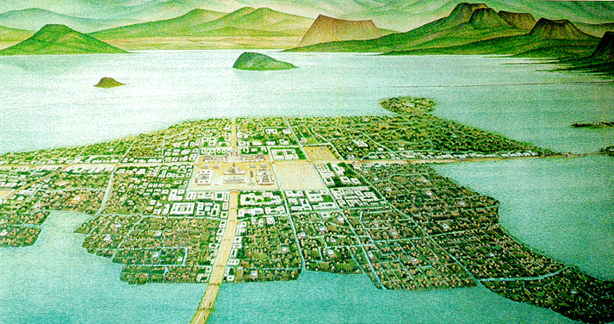
Tenochtitlan: Aztec Capital City

Slide 6
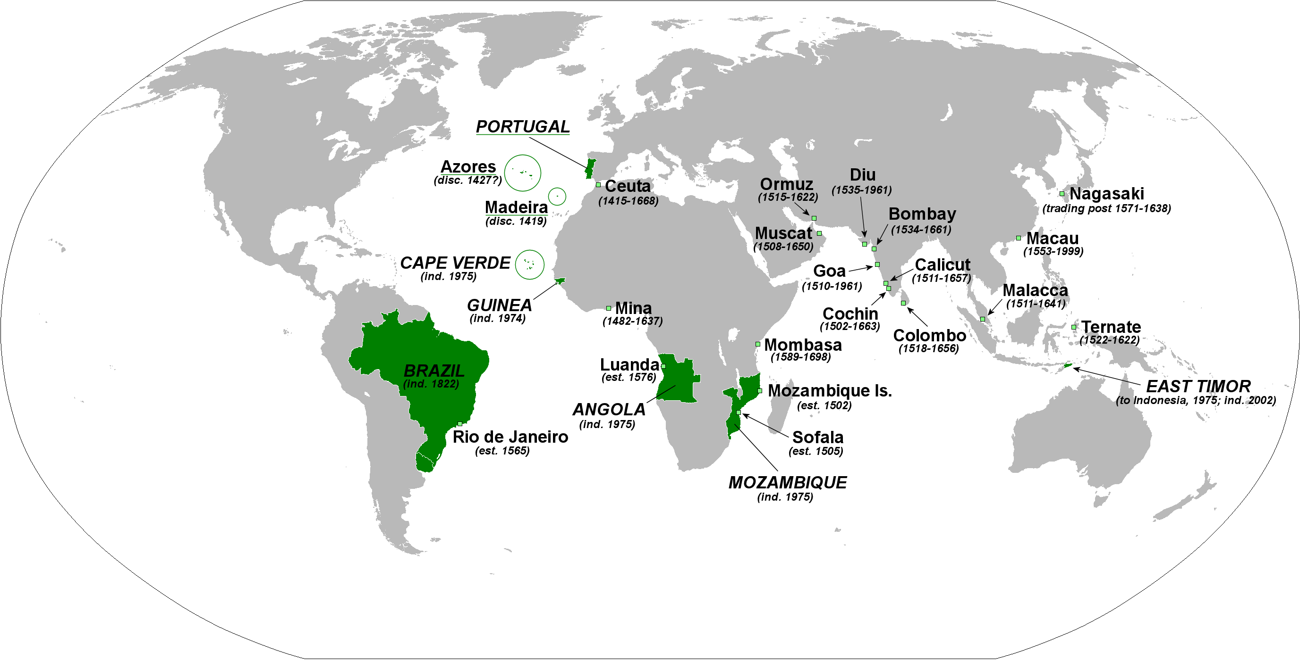
Europeans Enter Africa
The Portuguese invent the Caravel
They began the slave trade along the African coast.

Slide 7
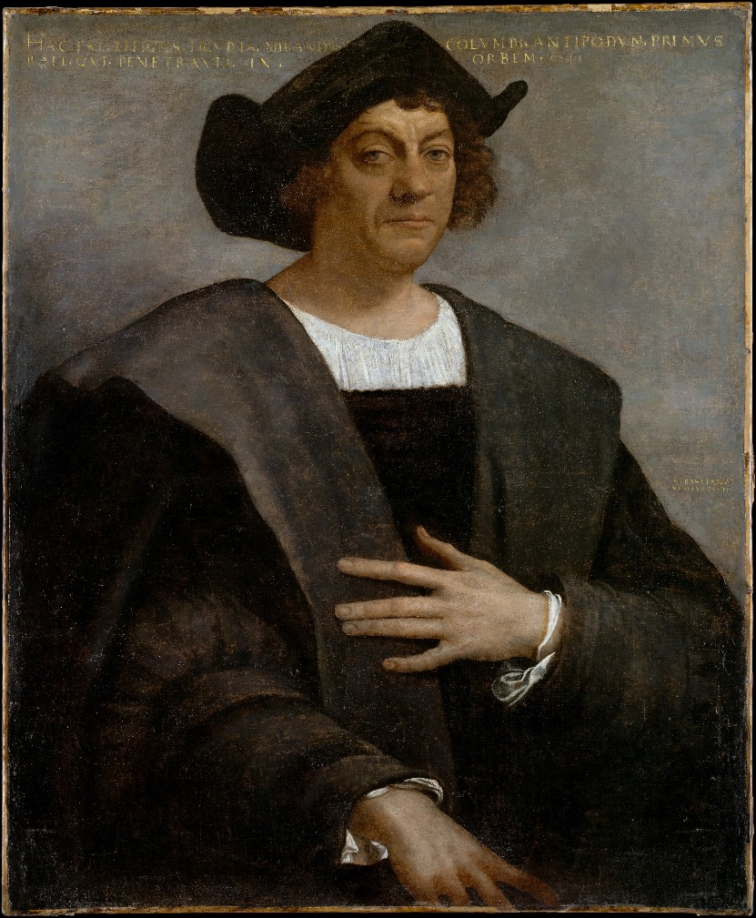
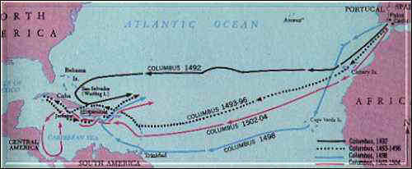
Columbus Comes Upon A New World
Columbus was looking for an alternate route to Asia.

Slide 8
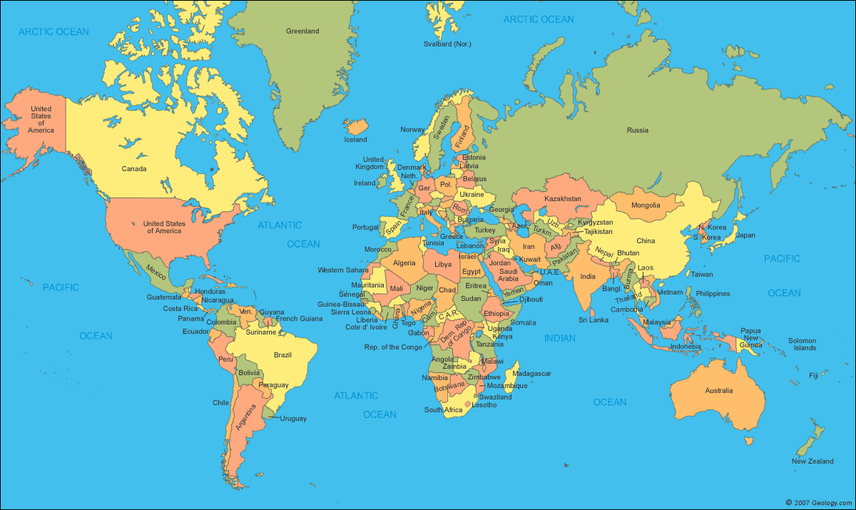
Columbus’ Goal

Slide 9
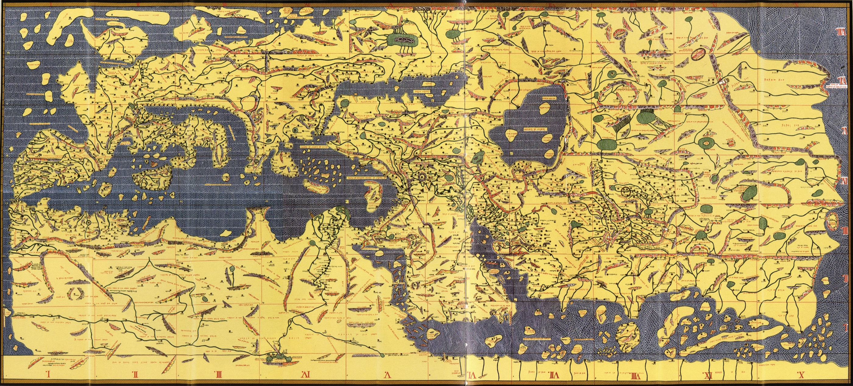
Map that Influenced Columbus

Slide 10
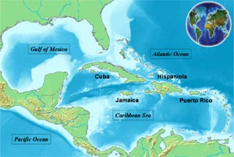
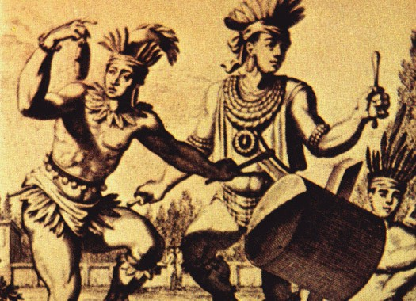
When Worlds Collide
Possibly 3/5 of the crops cultivated around the world today originated in the Americas.
Increase in global commerce (Globalization)
The Columbian Exchange
Natives die of disease
Taino [ty-no] tribe of Hispaniola

Slide 11
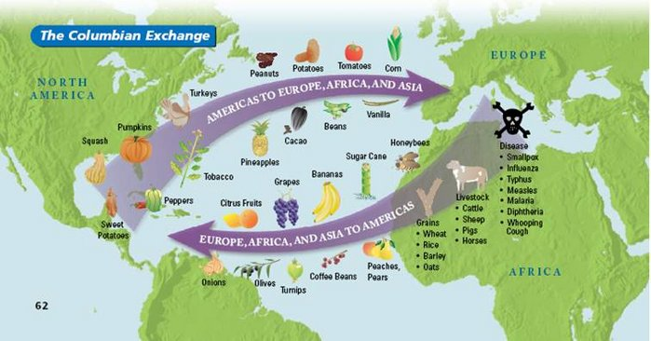
The Columbian Exchange

Slide 12
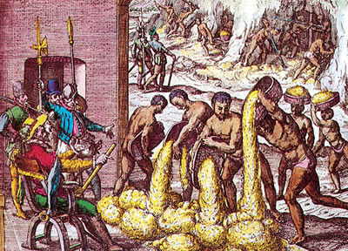
Encomienda
The Weak pay tribute to the Strong for protection.

Slide 13
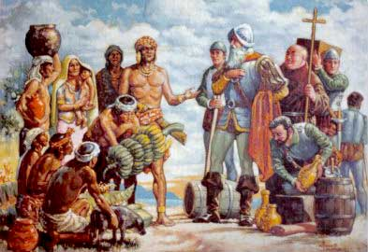
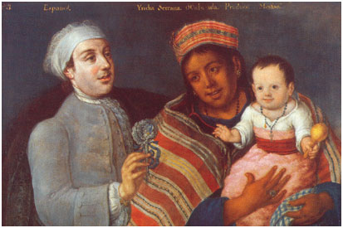
The Spanish Conquistadores
Treaty of Tordesillas
Spain and Portugal
In search of God, Gold, Glory
Mestizos
Spanish + Native = Mestizo

Slide 14
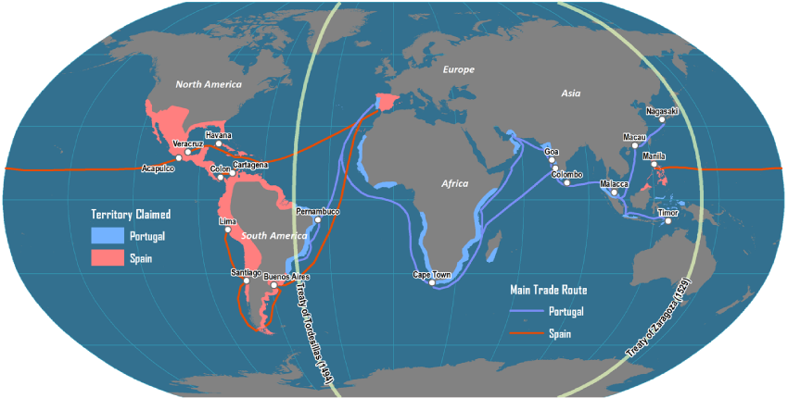
Treaty of Tordesillas (1494)

Slide 15
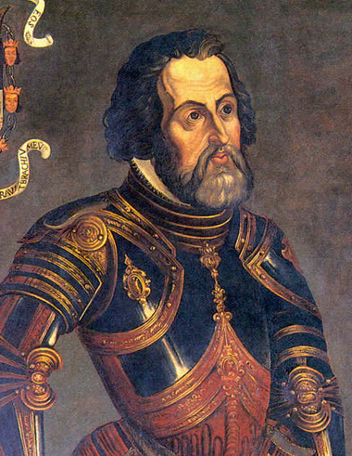
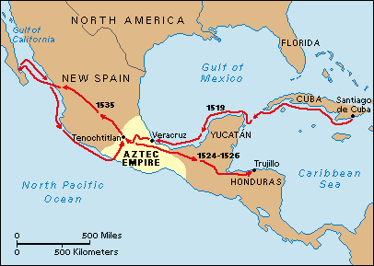
The Conquest of Mexico (1519-1521)
Hernan Cortes – Set sail from Hispaniola
Help from Malinche
Tenochtitlan
Aztec population
20 million to 2 million

Slide 16
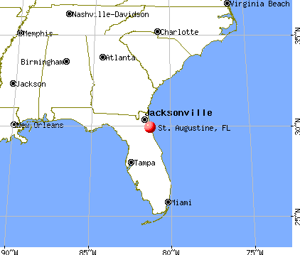
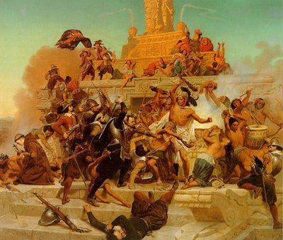
The Spread of Spanish America
Protection from Florida
St. Augustine
Pueblo Revolt (Pope’s Rebellion)
Present Day New Mexico: 400 Spanish dead and driven out of the area.
Black Legend

Slide 17
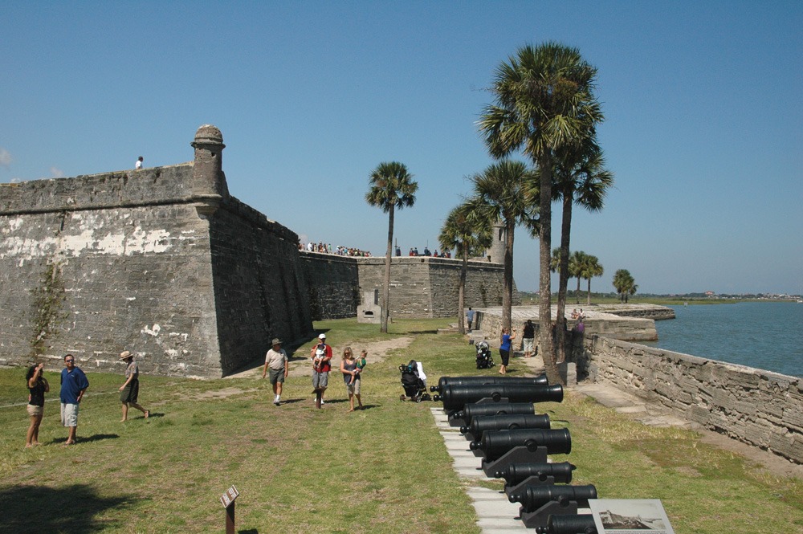
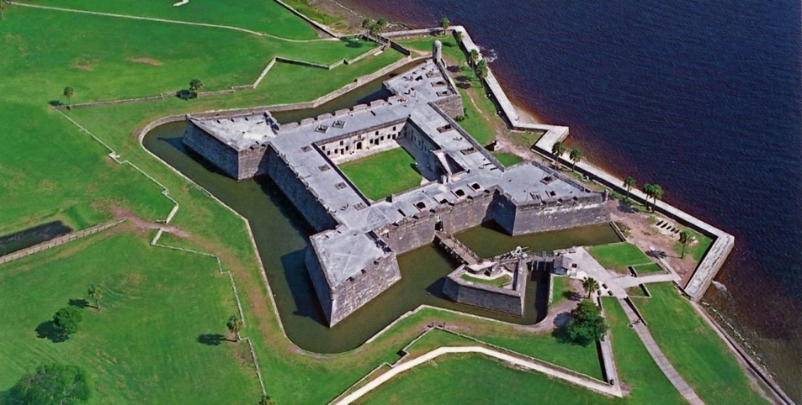
St. Augustine, Florida
Inside and Outside of Castillo de San Marcos

Slide 18
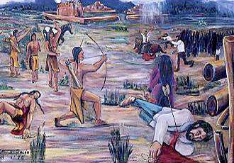
Pope’s Rebellion (Pueblo Revolt)

Slide 19
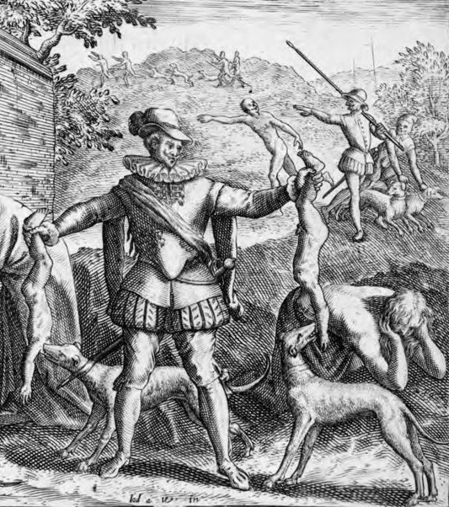
Black Legend
Engraving from the Late 1500s showing a Spaniard feeding native children to dogs.

