Slide 1
APUSH Review
Economics

Slide 2
Colonial Economies
New England – Lumber, ship-building, trade
Middle Colonies – “Bread basket”
The South – Cash Crops (Indigo, Tobacco, Cotton)
Mercantilism – Profits through trade and commercialism

Slide 3
Indentured Servitude
Labor system – early 1600s-roughly 1700
A person would pay for their travel to the New World by working for a set number of years
Not slavery, but a precursor to it
As the quality of life in Europe improved (1700s), the number of indentured servants dropped.

Slide 4
Slavery
An economic system where property laws include humans
Replaced indentured servitude – 1704 Virginia Slave Code
Legal in all colonies at one point
Slave Trade Compromise ended slave trade after 20 years (1787-1807)
Invention of the Cotton Gin in 1793 reinvigorated the demand for slaves
Slavery grew into a sectional issue through the 1850s and helped lead to the Civil War
13th Amendment officially ended the institution of slavery

Slide 5
Road to Revolution (Economics)
High cost of the French and Indian War (ended 1763)
The Stamp Act (1765, George Grenville) – raised taxes on the colonies to pay for the F&I War
The Townshend Acts (1767) duties on many items essential to the colonists
The Tea Act (1773) – The Townshend Acts were repealed except for the tax on tea

Slide 6
Market Revolution
As the United States expanded, so did their production capabilities.
Greater focus on capitalism and an increased specialization between the North and South
North – Industrial
South – Agriculture
Producing surpluses allowed for greater trade relations with other countries
Focus on using federal money to build roads, bridges

Slide 7
Boom and Bust Economy
Over speculation – no matter what type – happens when the economy is doing well (Boom)
Too much over speculation can lead to economic downturns (Bust)
Major Economic Panics
1819, 1837, 1857, 1873, 1893, 1907, 1929, 1970s, 2008

Slide 8
The Cotton Kingdom
Many southern states focused primarily on producing cotton.
Used a lot of manpower (slaves) and tied to the price of one crop.
If the price of cotton was high (good) if low (bad)
Plantation owners viewed attacks on slavery as attacks on their economic system – slaves were huge investments.
Prior to the Civil War, overproduction of cotton allowed the North and Britain to stockpile – less demand during war years.

Slide 9
The Industrial Revolution
Growing industry in the North fueled by new inventions and an influx of immigrant workers.
1840s and 50s – Irish and German
1880s and 90s – Eastern and Southern Europeans
The North outnumbers and out-produces the South
Railroads tie the country together – Transcontinental Railroad (1869)
Monopolists look to control money-making industries
Rockefeller (Oil), Carnegie (Steel), Vanderbilt (Railroads), Morgan (Finance)

Slide 10
Economics and War
Guns and Butter (Wartime v. Peacetime economies)
War usually causes an increase in production and lower unemployment
Civil War – Boom for the North increased factory production and railroad construction
World War I – Postwar boom due to producing for Europe
World War II – Marshall Plan rebuilding of Europe
Military Industrial Complex – Term used by President Dwight Eisenhower in 1961 to describe the growing connection between government and the defense industry.

Slide 11
The Roaring Twenties
“The Business of America is Business” – Calvin Coolidge
A period of economic prosperity came after World War I
Business regained a close connection with the government
Consumerism – A culture of buying and selling items
Installment Plans – Buying things on credit
Booming stock markets (speculation) – Borrowing money to buy risky stocks (Buying on margin)

Slide 12
The Great Depression
1929 Stock Market Crash – a major Bust due to over speculation in the Stock Market
The Dust Bowl – A series of droughts and poor growing seasons in the 1930s that contributed to the severity of the Great Depression.
Herbert Hoover attempted reforms to solve the Depression but they mostly failed
Smoot-Hawley Tariff – Raised tariffs and hurt consumers
Franklin D. Roosevelt’s New Deal – Relief, Recovery, Reform
First 100 Days – Massive legislation to correct the ills of the Depression
The Second World War eventually ended the Depression and production of the 50s continued the economic prosperity.

Slide 13
The Fifties
The Fifties saw America prosperous once again – just like in the 1920s.
The Marshall Plan – A plan to supply Europe with goods to rebuild their economies after WWII.
Construction of public highways and public schools
Movement to the suburbs as cars became more available – many people worked in the city but lived outside of it.
Return of consumerism.

Slide 14
Stagflation (1970s)
The boom of 50s slowed and the economy became stagnant
Through the late 60s and early 70s there was high inflation
Stagflation – Stagnant economic growth mixed with high inflation.
President Nixon attempted price freezes which did not solve the problem.
OPEC limited the supply of oil to the United States – caused rising prices and rationing
De-industrialization – Reduction of industrial capabilities
Caused by overproduction and greater competition from third-world countries.

Slide 15
Price of Oil

Slide 16
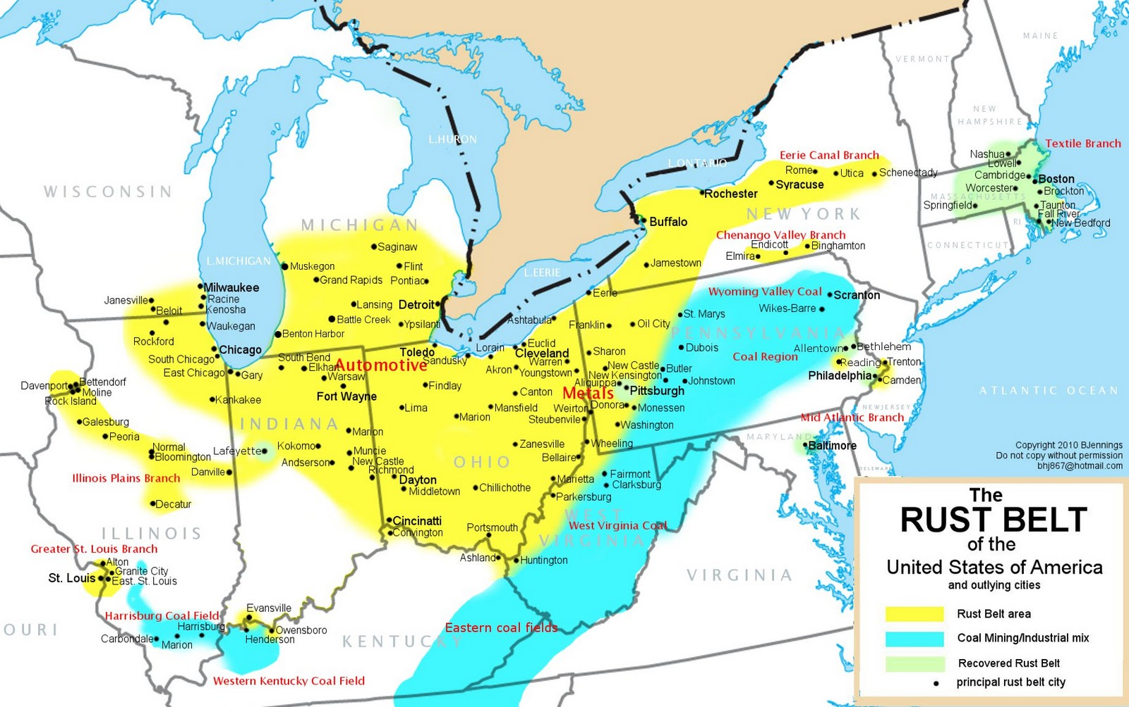
The Rust Belt

